Slide 1
LinkedIn JOB ANALYTICS
Presented By:-
Anand Kumhar
Jigyasu RaJPUROHIT
Shubham KUMAR
vasim KHAN

Slide 2
CONTENTS
OBJECTIVE
INTRODUCTION
INSIGHTS
DASHBOARD SCREENSHOTS
CHALLENGES
CONCLUSION

Slide 3
OBJECTIVE
Scrape and analyze data from LinkedIn by using python libraries and form 3 different tables.
Creating dashboard and visualizing insights.

Slide 4
INTRODUCTION
LinkedIn is an American business and employment oriented online service.
Python Libraries used:
Selenium
BeautifulSoup
Pandas
Time
SQL :- Finding Insights
Excel :- Visualizing Insights
Tableau :- Dashboard

Slide 5
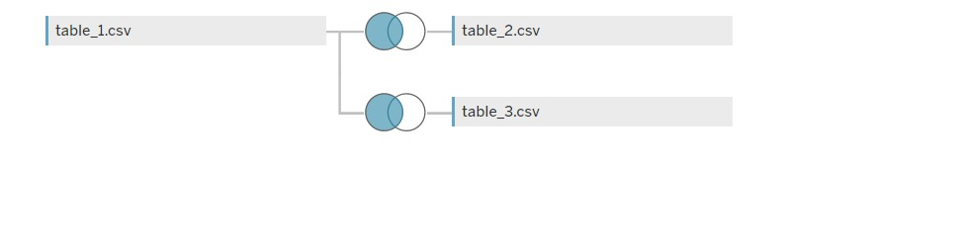
Join Table in Tableau

Slide 6
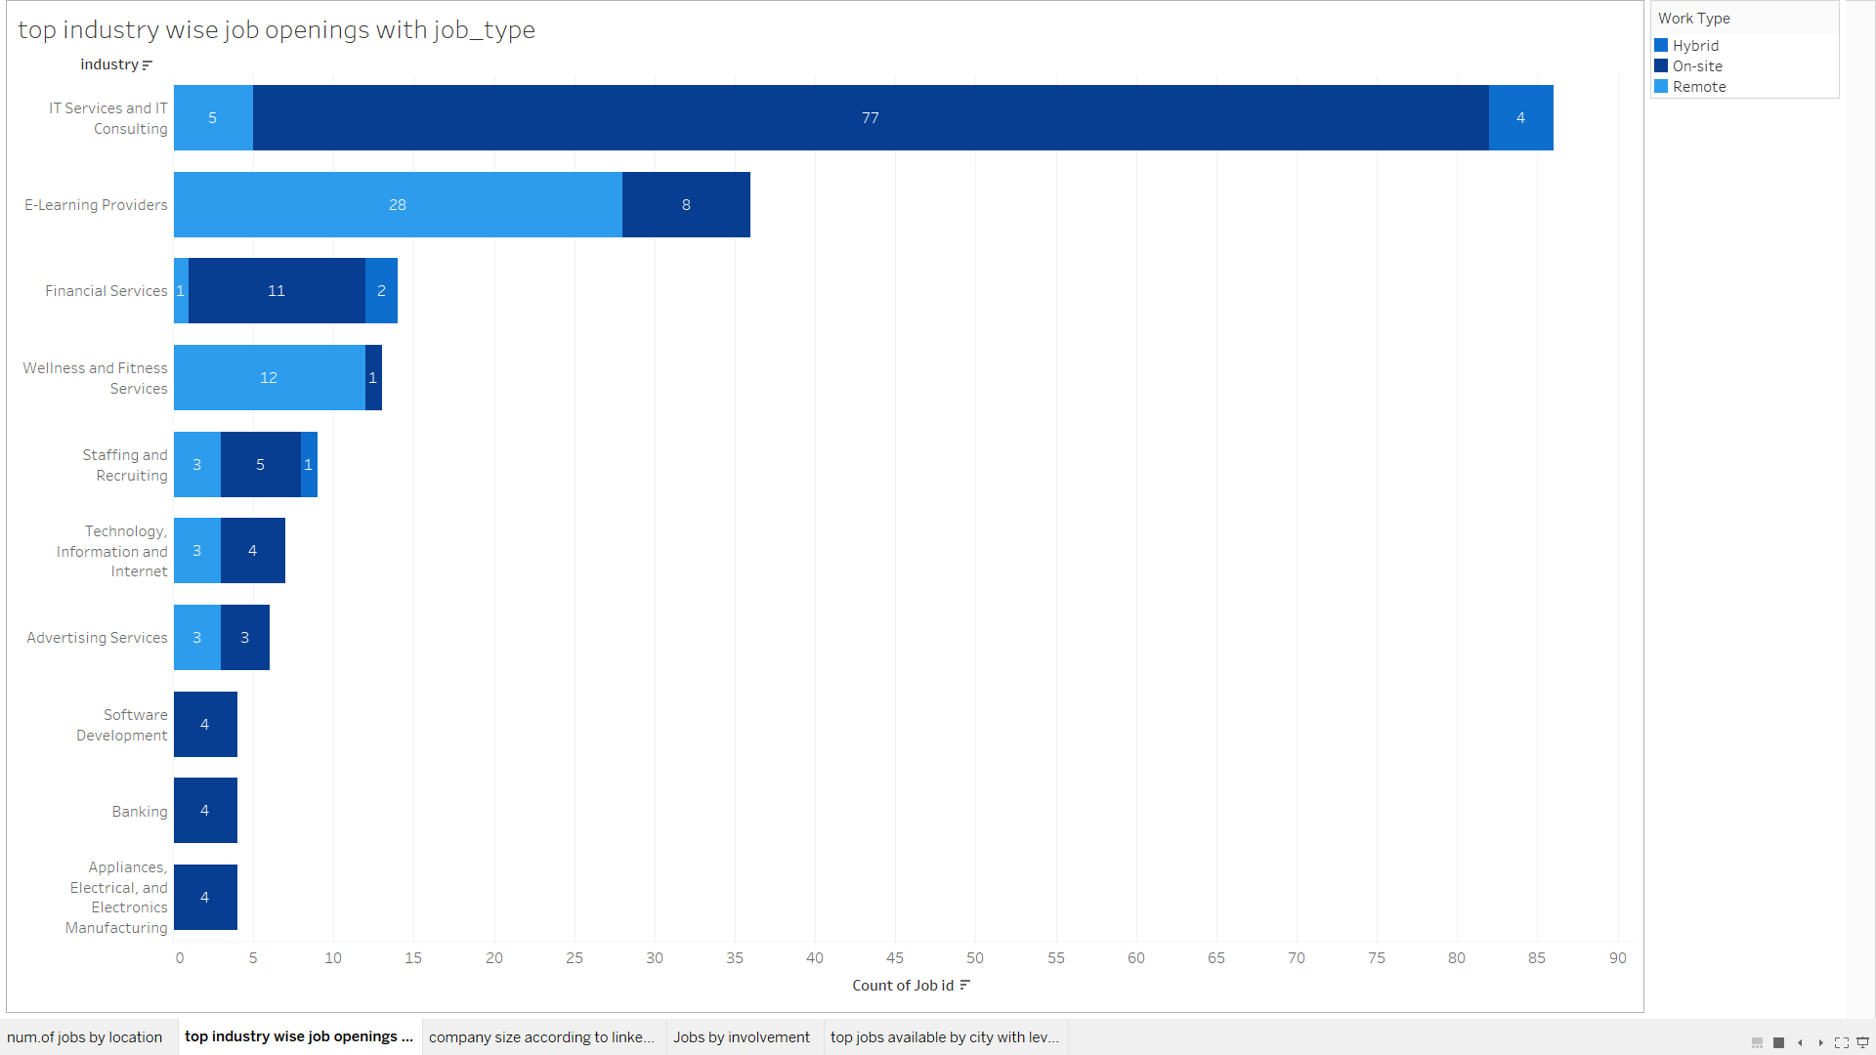
Top Industry Wise Job Openings with Job Type

Slide 7
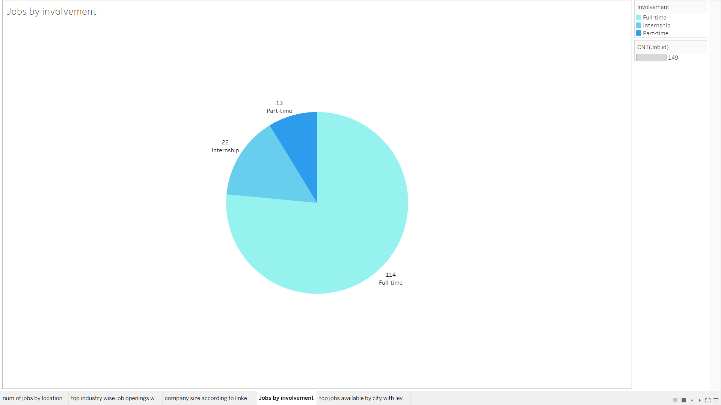
Jobs by Involvement

Slide 8
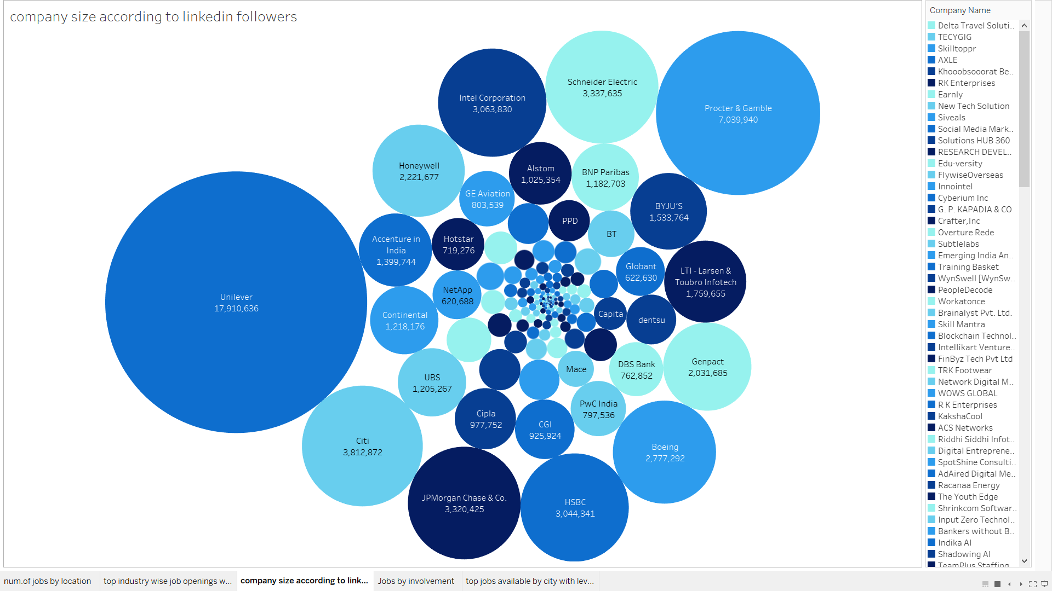
Company Size According To LinkedIn Followers

Slide 9
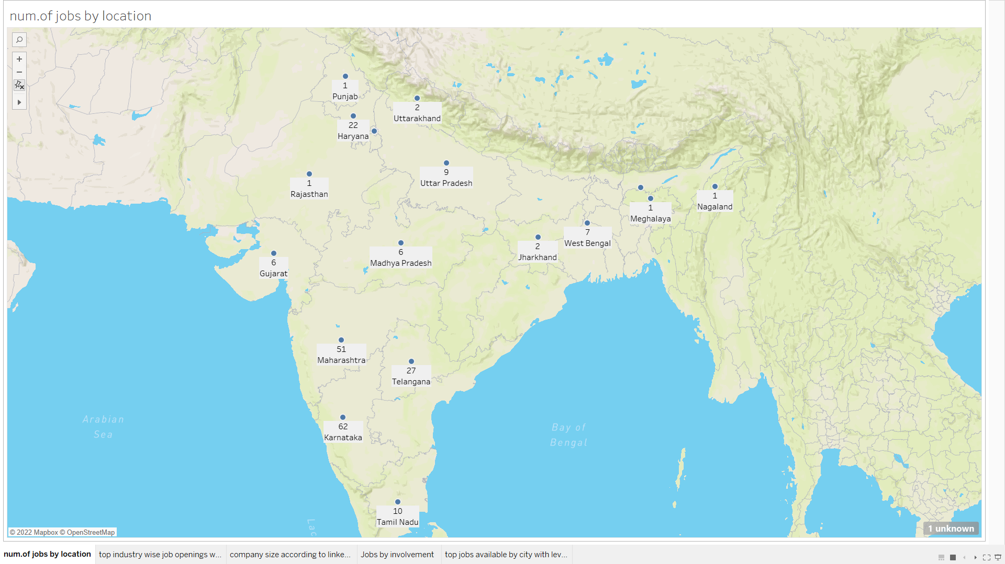
Number of Jobs by Location

Slide 10
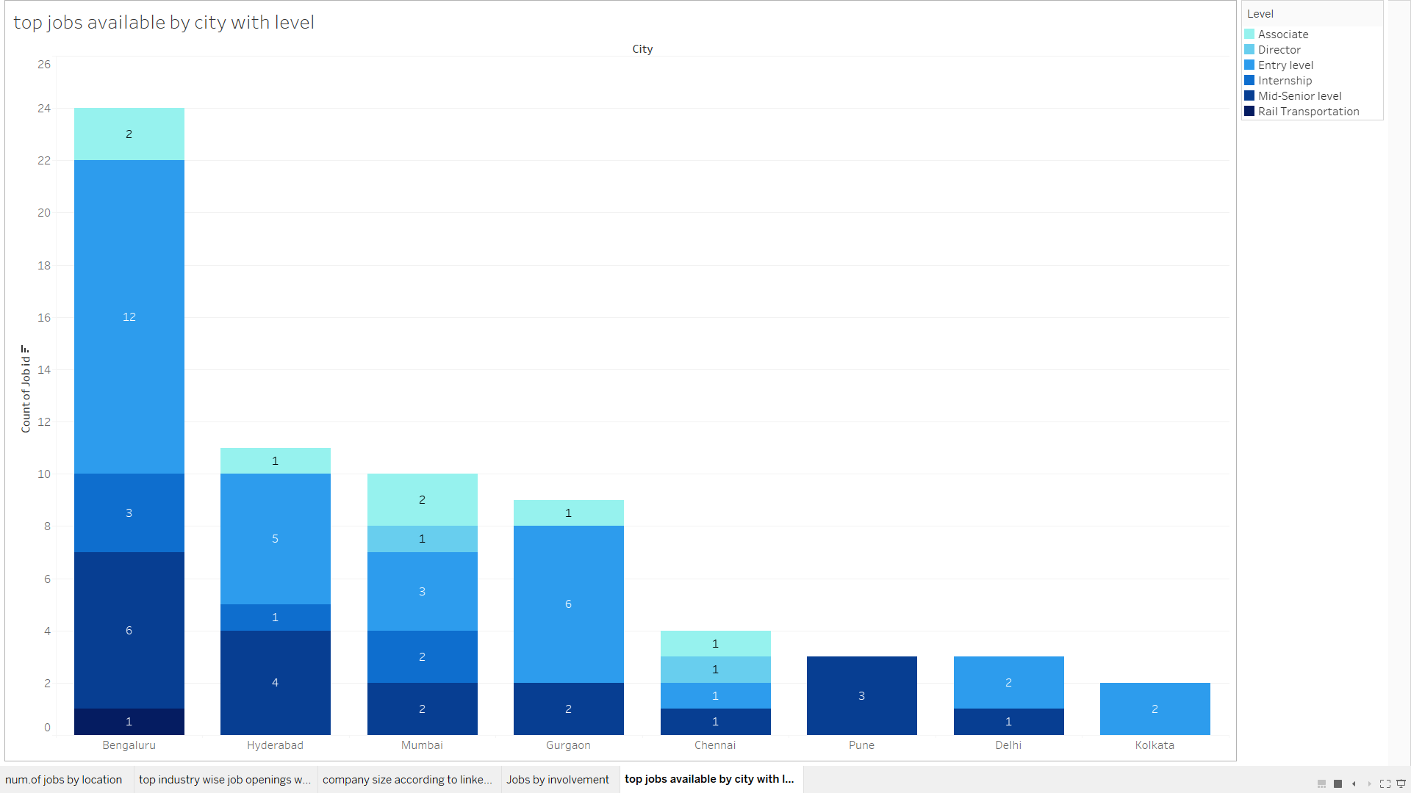
City wise Top Jobs (Level)

Slide 11
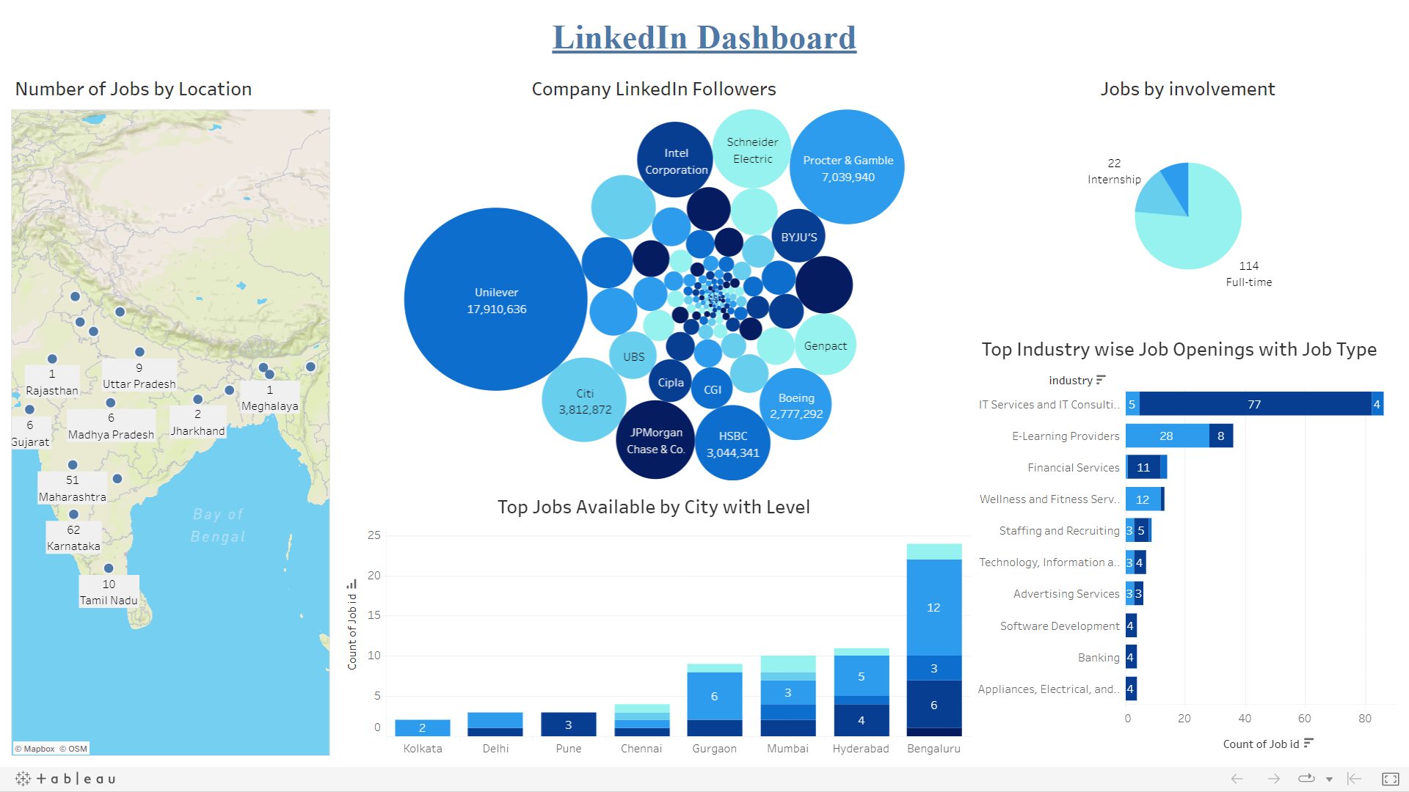

Slide 12
CHALLENGES FACED
All job data from LinkedIn website that need to be extracted was dynamic (APIs).
We made our code dynamic according to the requirement.
LinkedIn data was not in a proper format.
Understanding new innovative libraries of python.
Selenium
BeautifulSoup

Slide 13
CONCLUSION
Successful extraction of data from LinkedIn website.
More than 50% of jobs were posted from Maharashtra and Karnataka.
About 40% of the jobs were posted under ‘IT sector’.
Most popular company on LinkedIn is Unilever by followers data.
Mostly fulltime employees were being heired.
On-site recruitment was highest in IT sector and IT consulting.

